Slide 1
HOTEL DATA ANALYSIS … A Hotel Data analysis from 2018-2020

Slide 2
Questions
Approach & Analysis
Technical Challenges
Q1. Hotel Revenue & Growth
Q2. Parking lot Size
Q3. Trends in Data
Hotel revenue by category
Dashboard
Results
Content

Slide 3
Questions
Q1. Is our Hotel revenue Growing by year?
We have two hotel types so it would be good to segment revenue by hotel type.
Q2. Should we increase our parking lot size?
We want to understand if there is a trend with guests with personal cars.
Q3. What trends can we see in the data?
We will Focus on the average daily rate and guests to explore seasonality.

Slide 4
Approach and Analysis
1. Dataset: Hotel Revenue
2. Formatted, compiled, and cleaned in one single dataset
3. The columns Revenue, ADR, stays in weeknights, stays in weekend nights, discounts, required car parking space, and the different PLU codes will be considered to answer our questions
4. Statistical inference and graphical visualization will be employed.

Slide 5
Technical Challenges
The dataset contains Data in different sheets, our first job is to merge them with the help of SQL.
With The dataset being clean enough we have created new columns Discount & revenue.

Slide 6
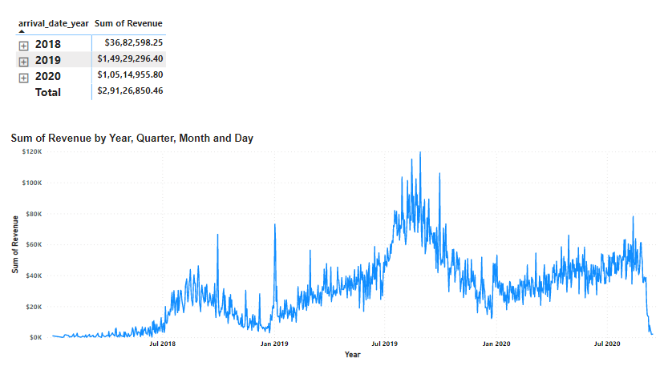
Q1. Is our Hotel revenue Growing by year?
Yes, our Hotel Revenue is growing, from 2018 to 2020(till September) we have a raise of 113.81% in revenue.
In 2018 our revenue is $3.68M, in 2019 it’s $14.93M and in 2020 it’s $10.51M .

Slide 7
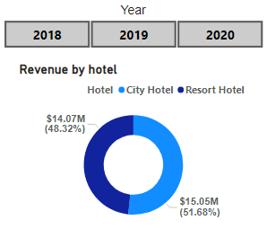
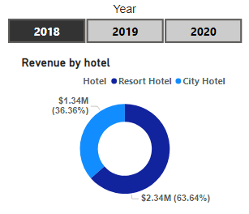
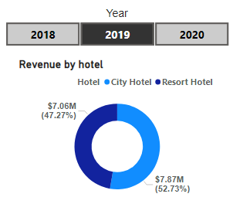
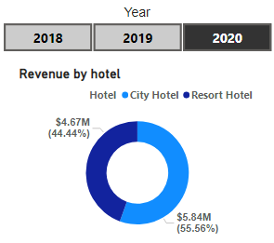
Category-wise Hotel Revenue
There are two categories in our hotel:
City Hotel
Resort Hotel

Slide 8
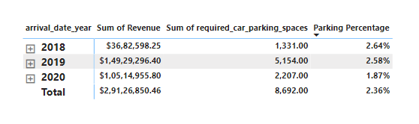
Q2. Should we increase our parking lot size?
We calculate parking percentage with the help of required car parking space and total nights spent by customers. In 2018 it was 2.64%, in 2019 it was 2.58% and in 2020 it was 1.87% .so to this data we can say that our parking is stagnated at around 2.5% and there is no need to increase our parking lot size.

Slide 9
Q3. What trends can we see in the data?
The trend we can see in our data :
Our Revenue is growing every year and has a very good rise of 113.81% from 2018 to 2020. our total revenue from 2018 to 2020 is $29.13 M.
Our ADR(average daily rate ) is growing. In 2018 our average of adr was $92.2, in 2019 it was $99.3 and in 2020 it was $118.7.
The average of adr trended up, resulting in a 108.74% increase between Saturday, January 20, 2018, and Monday, September 7, 2020.
Total Nights trended up, resulting in a 500.00% increase between Saturday, January 20, 2018 and Monday, September 7, 2020.
Our City hotel revenue is $15.5M (51.68%) and Resort hotel revenue is $14.07M(48.32%).
There is no need to increase our Parking lot size as vehicle parking is stagnated at around 2.5%.

Slide 10
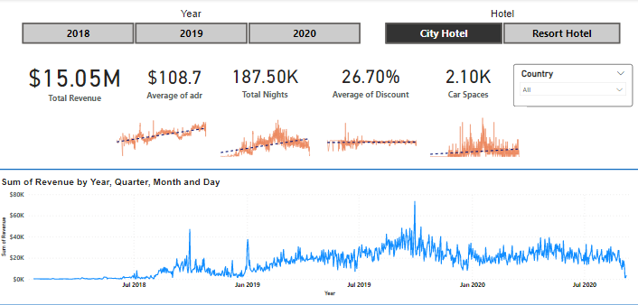
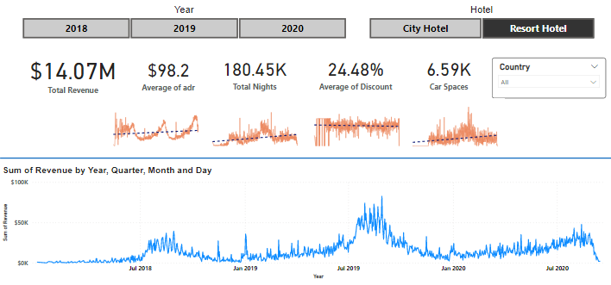
Hotel revenue by category
City Hotel
Resort Hotel

Slide 11
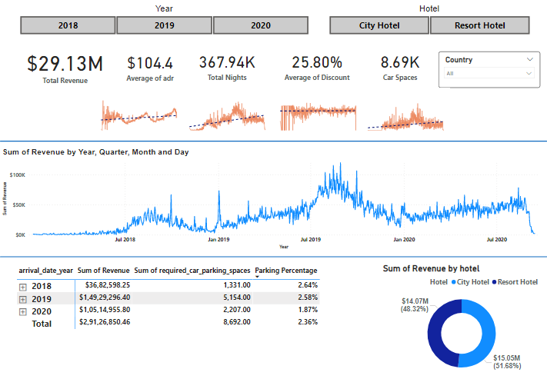
Dashboard

Slide 12
Results
Q1. Is our Hotel revenue Growing by year?
Yes, our Hotel Revenue is growing, from 2018 to 2020(till September) we have a raise of 113.81% in revenue. In 2018 our revenue is $3.68M, in 2019 it’s $14.93M and in 2020 it’s $10.51M.
Q2. Should we increase our parking lot size?
From the data, we can say that our parking is stagnated at around 2.5% and there is no need to increase our parking lot size.
Q3. What trends can we see in the data?
Our Revenue is growing every year and has a very good rise of 113.81% from 2018 to 2020
Our ADR(average daily rate ) is growing by 108.74% from 2018 to 2020.
Total Nights grew by 500% from 2018 to 2020.

